Slide 1
Out of reach?—A novel AR interface approach for motor rehabilitation
ISMAR 2011

Slide 2
INTRODUCTION
The incidence of stroke worldwide involves some 15 million people a year.
Motor deficits of the arm resulting in diminished quality of life are reported for approximately two thirds of stroke survivors.
Conventional therapies(physiotherapy)
improve motor skills
dependent on the severity of the stroke and the extent of the impairment
other approaches are developed that can assist with psychological as well as motor rehabilitation

Slide 3
INTRODUCTION
Mixed reality
TheraMem: a novel system that combines physical and psychological rehabilitation possibilities for the treatment of upper limb impairments.
AR and Casual gaming
Quantitative and qualitative studies are then presented to evaluate the usability and utility of the system
fool the senses

Slide 4
INTRODUCTION
Mixed reality
TheraMem: a novel system that combines physical and psychological rehabilitation possibilities for the treatment of upper limb impairments.
AR and Casual gaming
Quantitative and qualitative studies are then presented to evaluate the usability and utility of the system
fool the senses

Slide 5
THE THERAMEM SYSTEM
a hardware and software system based on the following general assumptions:
a) The system can be used for physical functional and motor rehabilitation, in particular for after-stroke therapy.
b) A simple computer game approach increases user motivation and may change individuals’ perceptions and beliefs about their impairments.
c) Controlled amplification of the movement of an impaired limb can lead to improvement of motor movement and in particular the range of reaching and selection movements.

Slide 6
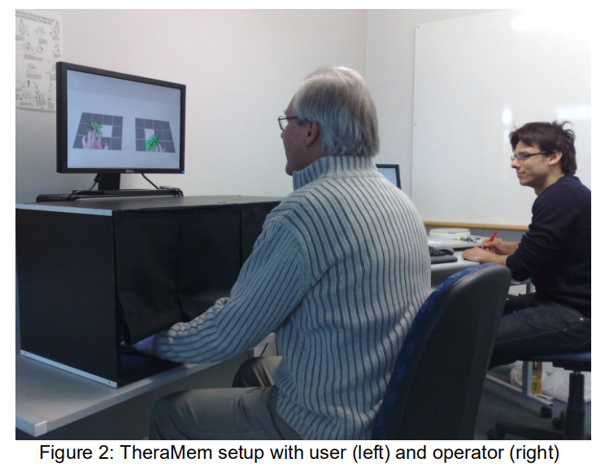
THE THERAMEM SYSTEM
Hardware:
(a)(non-)visibility of the user’s hands
(b)lighting
(c)background subtraction
(d)augmented visualization as well as interactive control.
System:
(a) the development and integration of a game environment
(b) the development of finger tracking to be used to
(c) amplify the visual hand movements

Slide 7
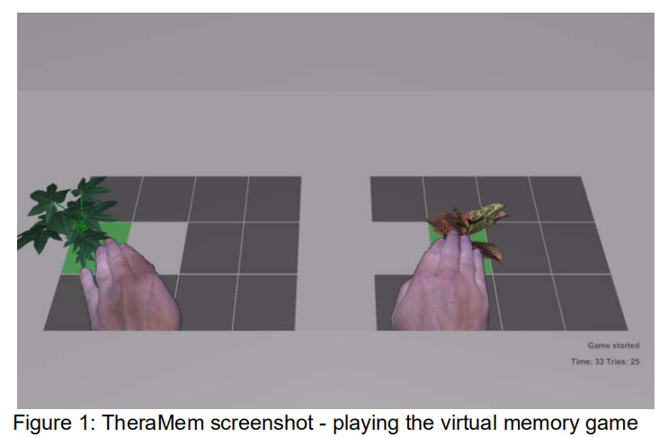
THE THERAMEM SYSTEMs

Slide 8
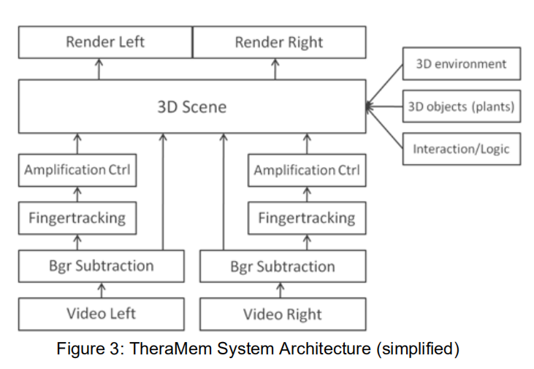
SYSTEM ARCHITECTURE

Slide 9
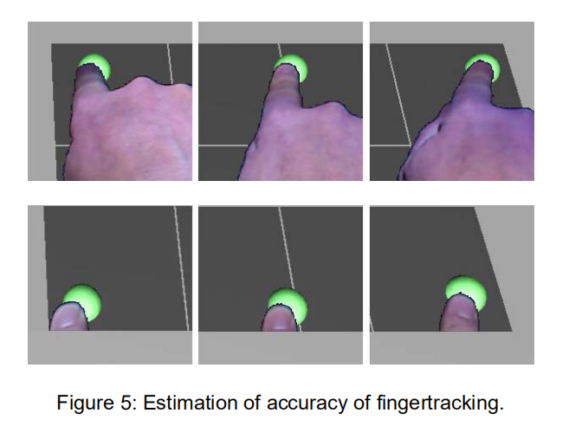
HAND EXTRACTION AND FINGER TRACKING

Slide 10
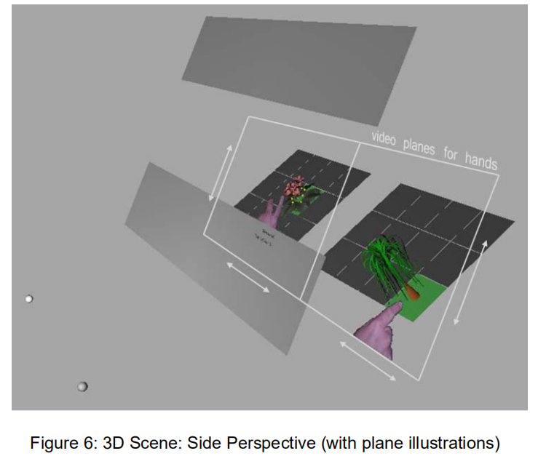
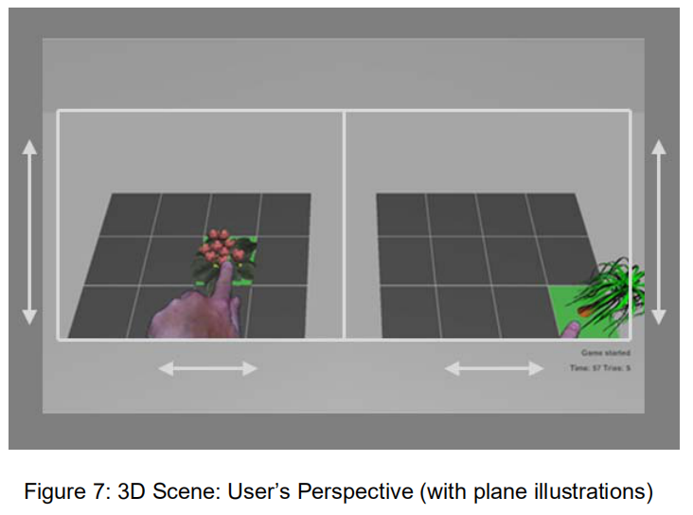
AUGMENTED REALITY ENVIRONMENT

Slide 11
USABILITY EVALUATION
Effectiveness
(a) Is the simple memory game playable?
(b) Can all matching pairs be successfully located?
(c) Is the game still playable if hand movement is amplified?
(d) To what extent is amplification noticed by users and does this detract from the game?
Efficiency
(a) the reaction time of the system to user interaction
(b) the reaching and selection performance of the system
(c) the time and number of attempts required to complete the task
Satisfaction
(a) the perceived ease and enjoyment of use
(b) the perceived effectiveness and efficiency of game play
(c) the perceived comfort and level of mastery and control of the system

Slide 12
PARTICIPANTS
Forty-five participants (10 female and 35 male)
22 in Part A and 23 in Part B
Two participants (1 male and 1 female) were excluded because of vision and age eligibility criteria.
The age of the 43 participants ranged from 21 to 69 years (M = 37.8, SD = 13.5).
Participants had no prior knowledge of the experiment.
They were recruited from academic, administrative and technical staff and graduate students from different university departments.
Participants were required to have normal, or corrected to normal
vision to be eligible

Slide 13
CONDITIONS AND APPARATUS
Part A
the participants were not told about changes in amplification;
they were simply informed that some technical changes were applied in between the rounds.
Part B
participants were explicitly told that their hand movements were amplified.
They were not informed about which hand was being amplified or to what degree

Slide 14
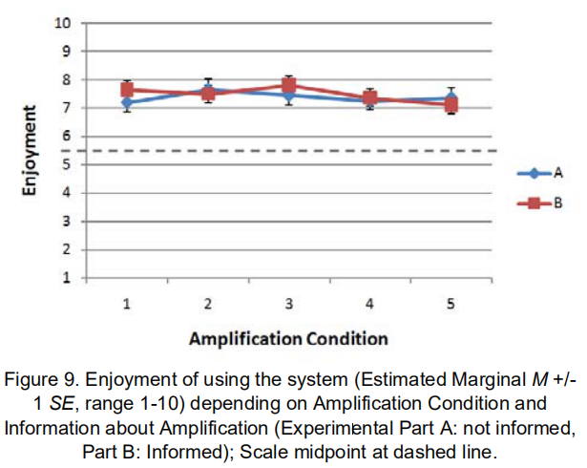
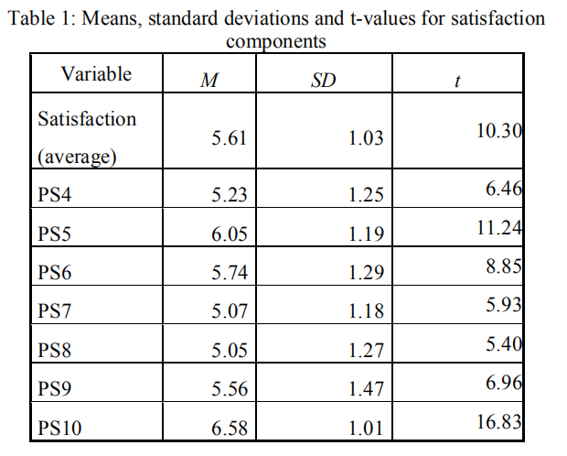
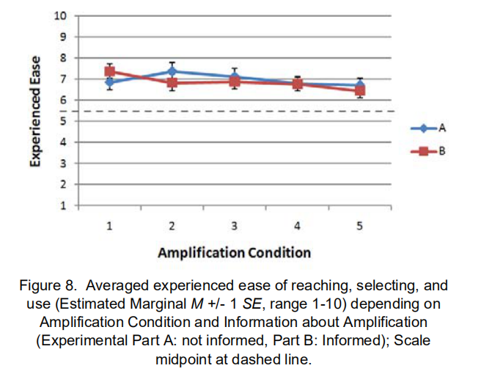
RESULTS
five amplification conditions(0.0, 1.0, 1.5, 2.0, 2.5)

Slide 15
UTILITY EVALUATION
We were interested whether scholars and students, clinical experts, and practitioners in physiotherapy would confirm our assumptions about how the system could be used in physical rehabilitation.
We also wanted to explore other potential applications for the system.
Student Evaluations
(1) Explain the system to peers in a brief statement
(2) Envisage the system being used for motor rehabilitation
(3) Define a satisfactory outcome as a result of using the system in therapy.

Slide 16
UTILITY EVALUATION
Two one hour workshops
a PowerPoint seminar type presentation
a live demonstration of the system
the opportunity for the attendees to try TheraMem for themselves
Guided Interviews
Seven experienced practitioners
appropriate and manageable complexity
highly rated
highly desirable
more sense-related features

Slide 17
CONCLUSIONS AND FUTURE WORK
TheraMem is a novel system which combines Augmented Reality, a simple computer game, and spatial-visual decoupling of the user’s hands for use in post-stroke rehabilitation.
The system also adds to the growing evidence that virtual and augmented technology can be used to “fool the senses” and to “fool the brain” with a (good) purpose.
Our own platform can be used to teach memory skills as well as an awareness of impairments.
We look forward to reporting the outcomes of this work in due course.

